Slide 1
Basics of Machine Learning with Python
A 2 day hands on workshop by Evam Kaushik

Slide 2

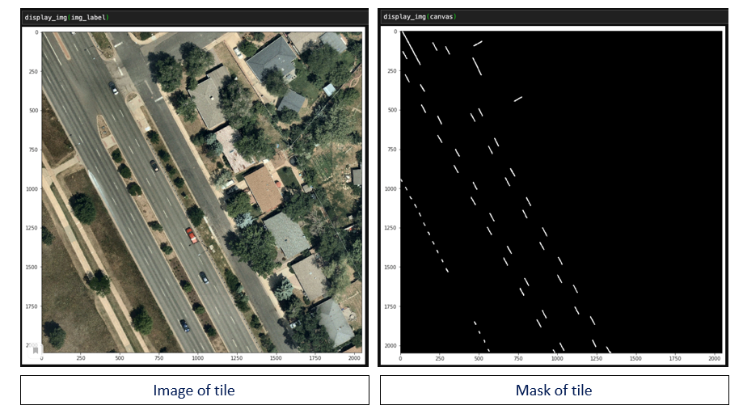
Bit about myself
I’m a machine learning researcher currently employed by
Here Tech is subset of NOKIA that deals with location data
Here Technologies
To help work on Semantic Image Segmentation using Machine Learning

Slide 3



I am pursuing a Bachelors Degree in Computer Science and Engineering from Symbiosis Institute of Technology, Pune.
I’m very passionate about Machine Learning.
My Specialization is in Deep Learning and Computer Vision.
I have several hobbies like Guitar, Piano, Sketching and Martial arts.
You can connect with me on
Instagram : evam.Kaushik
LinkedIn : Evam Kaushik

Slide 4
Day 1 Schedule
Python
Data types
Variables and data storage
Built-in and Custom Functions
Conditional Statements
Iteration with Loops
NumPy library for Scientific Computation

Slide 5
Data Types
There are various data types for example
Integers
Floating point numbers
Booleans
Strings

Slide 6
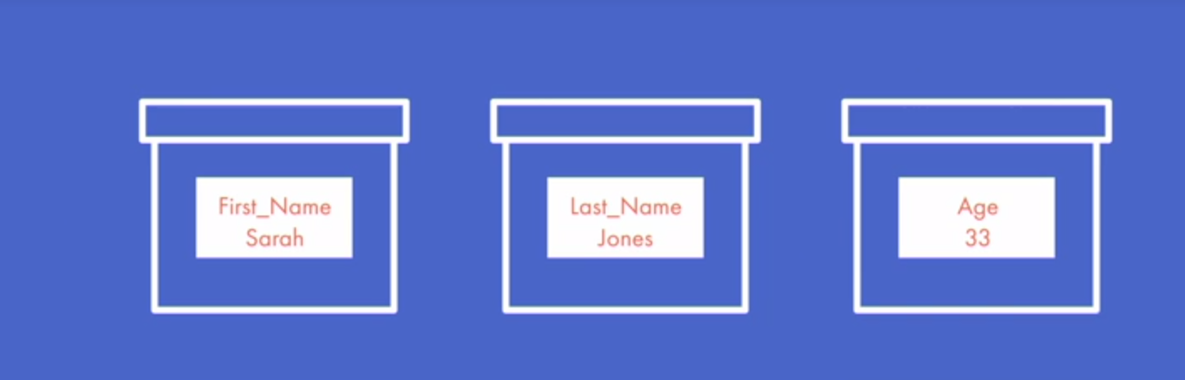
Variables
A variable in programming is like a storage box. You can use a variable to store any kind of information or data. Variables are useful because you can access and change the contents of a variable anytime you want. So I want to help you learn how to create your own variable. Let's go back to the storage box analogy. If you're organizing or packing some things, you may divide your things in to categories based on what they are or what they're used for, and put them into boxes. Then, you might label the boxes with a short word or phrase indicating what the boxes contain. Similarly to create a variable, you must provide a name that indicates what the variable contains and provide the value of the variable, which is the data you want to store in the variable.

Slide 7
Functions
A programmer's main goal is not just to solve problems through coding but to do so efficiently. When you're programming, you may find yourself typing the same set of instructions in multiple places in your program. When you do this, it not only takes longer for you to write and read your code, but also takes longer for your computer to read and follow your instructions. One major way to be concise is to use functions.
Functions can be used to store repeating pieces of code.

Slide 8
Built-in Functions
Python has some functions that have already been defined. These are called built-in functions, and they are available for you to use anytime.
Print
A handy built-in function is print, and in programming printing means, showing something on the screen. So the print function in Python takes in data and prints out the data so that it's displayed on the screen.
Input
The input function allows you to ask the user for data and receive that data for you to work with. When you use the input function, you want to specify a prompt that will be displayed to the user as well as create a variable that will store the user's typed response to the prompt.

Slide 9
Custom Functions
Built in functions are powerful, but there will be times when you need to create your own functions to help you complete specific tasks. There are several types of functions.
Don’t receive input and don’t generate output
Receive input but don’t generate output
Receive input and generate output

Slide 10
Modules
A critical skill in programming is knowing how to reuse, and by reuse, I mean take advantage of code that has already been written. In Python, one of the main ways to do this is by using modules, and modules contain code that has already been written. I'm going to help you learn how to make use of modules when you code.

Slide 11
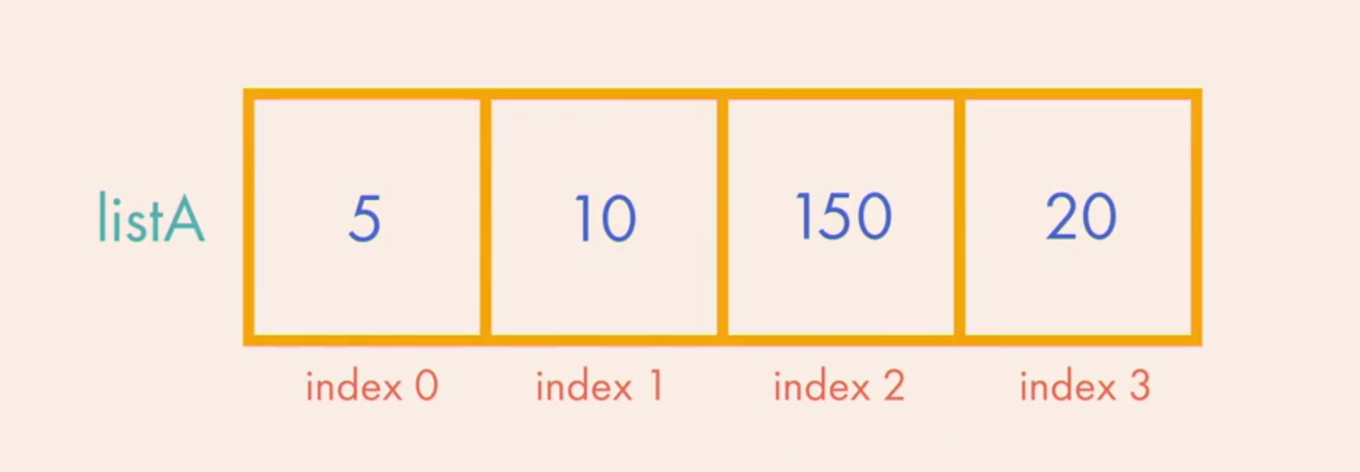
Lists
When you're programming, you'll often need to store some data to use throughout your program. That could be individual pieces of data and collections of data.
A list has a specific order and the items in the list can be changed whenever you want. Square brackets are used to enclose the items in the list and commas are used to separate the items from each other.

Slide 12
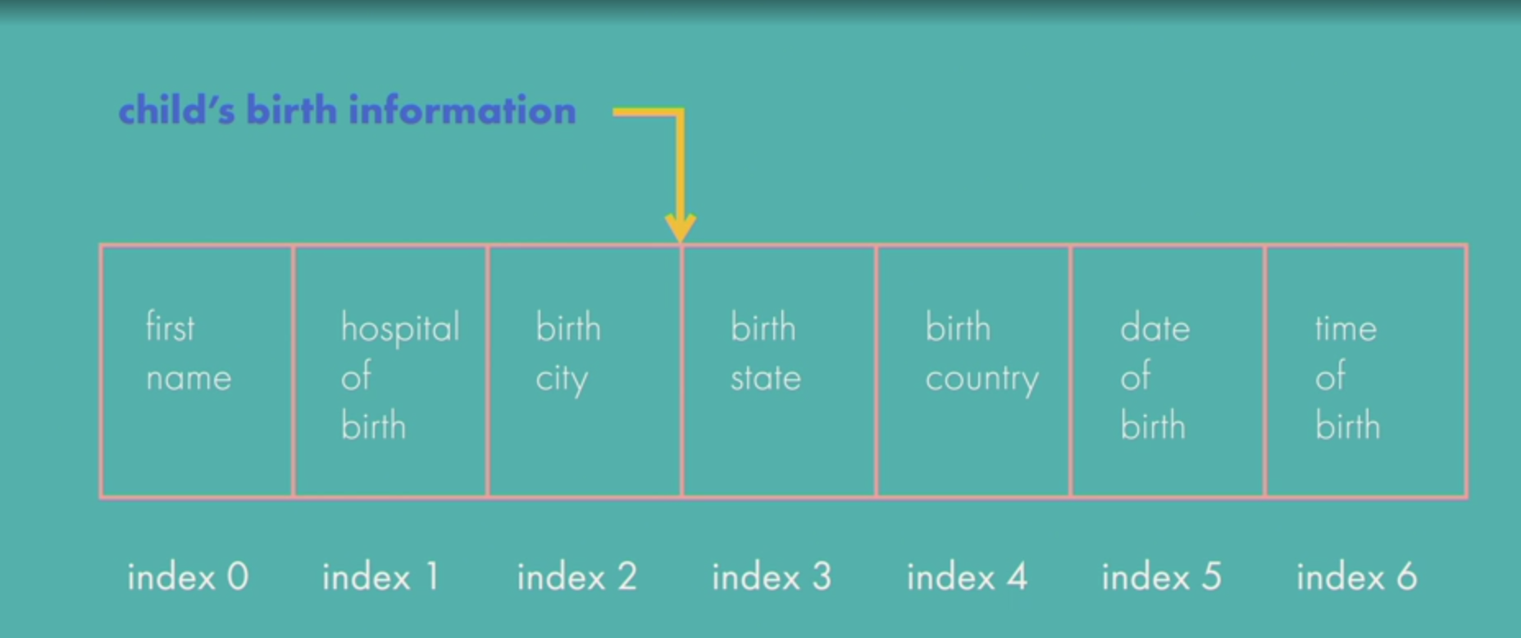
Tuples
When working with collections of data, you might encounter a situation where you want to store some information in a sequence and ensure that the sequence is not changed afterwards. Say you're given a task involving a set of children's birth information. For each child, you have their first name, the hospital where they were born, their birth city, their birth state, their birth country, their date of birth and their time of birth. You want to store the birth information of each child in a sequence. You do not want that sequence to be tampered with or altered, so you need to use a sequence that cannot be changed after creation. Don't worry, Python has a type of sequence that helps you do this easily and it's called a tuple. A tuple has a specific order and the items in a tuple cannot be changed once created. Parentheses are used to enclose the items in the tuple and commas are used to separate the items from each other.

Slide 13
Conditional Statements
Often times when you're programming you'll need to control the flow of your program's execution and conditional statements can help you with that. A conditional statement instructs the computer to perform specific actions if specifics conditions are met.
Following are the conditional statements we will be learning about
If
Else
Elif

Slide 14
Iteration
Process of repeatedly performing instructions. We will discuss the following types of iteration functions :
For loops
They iterate over a range of numbers or
Over the items of a list
While loops
They iterate until a given set of condition is true or false

